Slide 1

Why Study the Theory of Computation?
Implementations come and go.
Chapter 1

Slide 2
IBM 7090 Programming in the 1950’s
ENTRY SXA 4,RETURN
LDQ X
FMP A
FAD B
XCA
FMP X
FAD C
STO RESULT
RETURN TRA 0
A BSS 1
B BSS 1
C BSS 1
X BSS 1
TEMP BSS 1
STORE BSS 1
END

Slide 3
Programming in the 1970’s
(IBM 360)
//MYJOB JOB (COMPRESS),
'VOLKER BANDKE',CLASS=P,COND=(0,NE)
//BACKUP EXEC PGM=IEBCOPY
//SYSPRINT DD SYSOUT=*
//SYSUT1 DD DISP=SHR,DSN=MY.IMPORTNT.PDS
//SYSUT2 DD DISP=(,CATLG),
DSN=MY.IMPORTNT.PDS.BACKUP,
// UNIT=3350,VOL=SER=DISK01,
// DCB=MY.IMPORTNT.PDS,
SPACE=(CYL,(10,10,20))
//COMPRESS EXEC PGM=IEBCOPY
//SYSPRINT DD SYSOUT=*
//MYPDS DD DISP=OLD,DSN=*.BACKUP.SYSUT1
//SYSIN DD *
COPY INDD=MYPDS,OUTDD=MYPDS
//DELETE2 EXEC PGM=IEFBR14
//BACKPDS DD DISP=(OLD,DELETE,DELETE),
DSN=MY.IMPORTNT.PDS.BACKUP

Slide 4

Guruhood
Notes:
Returns 1 if the largest element in a three-element vector is greater than the sum of the other two. Otherwise, returns 0.

Slide 5
Applications of the Theory
FSMs for parity checkers, vending machines, communication protocols, and building security devices.
Interactive games as nondeterministic FSMs.
Programming languages, compilers, and context-free grammars.
Natural languages are mostly context-free. Speech understanding systems use probabilistic FSMs.
Computational biology: DNA and proteins are strings.
The undecidability of a simple security model.
Artificial intelligence: the undecidability of first-order logic.

Slide 6
Limitations of Mathematics
This sentence is false.

Slide 7
Limitations of Computing
Is my program correct?

Slide 8
Languages and Strings
Chapter 2

Slide 9
Let's Look at Some Problems
int alpha, beta;
alpha = 3;
beta = (2 + 5) / 10;
(1) Lexical analysis: Scan the program and break it up into variable names, numbers, etc.
(2) Parsing: Create a tree that corresponds to the sequence of operations that should be executed, e.g.,
/
+ 10
2 5
(3) Optimization: Realize that we can skip the first assignment since the value is never used and that we can precompute the arithmetic expression, since it contains only constants.
(4) Termination: Decide whether the program is guaranteed to halt.
(5) Interpretation: Figure out what (if anything) useful it does.

Slide 10
A Framework for Analyzing Problems
We need a single framework in which we can analyze a very diverse set of problems.
The framework we will use is
Language Recognition
A language is a (possibly infinite) set of finite length strings over a finite alphabet.

Slide 11
Strings
A string is a finite sequence, possibly empty, of symbols drawn from some alphabet Σ.
• ε is the empty string.
• Σ* is the set of all possible strings over an alphabet Σ.
Alphabet name | Alphabet symbols | Example strings
The English alphabet | {a, b, c, …, z} | ε, aabbcg, aaaaa
The binary alphabet | {0, 1} | ε, 0, 001100
A star alphabet | { , ☺ , 😐 , , , } | ε, ☺☺, 
A music alphabet | {♩,♪,♫,♬,♭,♮,♯,|} | ε, ♪,♪|♬♬♬

Slide 12
Functions on Strings
Length: |s| is the number of symbols (characters, letters) in s.
|ε| = 0
|1001101| = 7
#_{c}(s) is the number of times that c occurs in s.
#_{a}(abbaaa) = 4.

Slide 13
More Functions on Strings
Concatenation: st is the concatenation of s and t.
If x = good and y = bye, then xy = goodbye.
Note that |xy| = |x| + |y|.
ε is the identity for concatenation of strings. So:
∀x (x ε = ε x = x).
Concatenation is associative. So:
∀s, t, w ((st)w = s(tw)).

Slide 14
More Functions on Strings
Repetition (or power): For each string w and each natural number i, the string w^{i} is:
w⁰ = ε
w^{i+1} = w^{i} w
Examples:
a³ = aaa
(bye)² = byebye
a⁰b³ = bbb

Slide 15
More Functions on Strings
Reverse: For each string w, w^{R} is defined as:
if |w| = 0 then w^{R} = w = ε
if |w| ≥ 1 then:
∃a ∈ Σ (∃u ∈ Σ* (w = ua)).
So define w^{R} = a u ^{R}.

Slide 16
Concatenation and Reverse of Strings
Theorem: If w and x are strings, then (w x)^{R} = x^{R} w^{R}.
Example:
(nametag)^{R} = (tag)^{R} (name)^{R} = gateman

Slide 17
Concatenation and Reverse of Strings
Proof: By induction on |x|:
|x| = 0: Then x = ε, and (wx)^{R} = (w ε)^{R} = (w)^{R} = ε w^{R} = ε^{R} w^{R} = x^{R} w^{R}.
∀n ≥ 0 (((|x| = n) → ((w x)^{R} = x^{R} w^{R})) →
((|x| = n + 1) → ((w x)^{R} = x^{R} w^{R}))):
Consider any string x, where |x| = n + 1. Then x = u a for some character a and |u| = n. So:
(w x)^{R} = (w (u a))^{R} rewrite x as ua
= ((w u) a)^{R} associativity of concatenation
= a (w u)^{R} definition of reversal
= a (u^{R} w^{R}) induction hypothesis
= (a u^{R}) w^{R} associativity of concatenation
= (ua)^{R} w^{R} definition of reversal
= x^{R} w^{R} rewrite ua as x

Slide 18
Relations on Strings
aaa is a substring of aaabbbaaa
aaaaaa is not a substring of aaabbbaaa
aaa is a proper substring of aaabbbaaa
Every string is a substring of itself.
ε is a substring of every string.

Slide 19
The Prefix Relations
s is a prefix of t iff: ∃x ∈ Σ* (t = sx).
s is a proper prefix of t iff: s is a prefix of t and s ≠ t.
Examples:
The prefixes of abba are: ε, a, ab, abb, abba.
The proper prefixes of abba are: ε, a, ab, abb.
Every string is a prefix of itself.
ε is a prefix of every string.

Slide 20
The Suffix Relations
s is a suffix of t iff: ∃x ∈ Σ* (t = xs).
s is a proper suffix of t iff: s is a suffix of t and s ≠ t.
Examples:
The suffixes of abba are: ε, a, ba, bba, abba.
The proper suffixes of abba are: ε, a, ba, bba.
Every string is a suffix of itself.
ε is a suffix of every string.

Slide 21
Defining a Language
A language is a (finite or infinite) set of strings over a finite alphabet Σ.
Examples: Let Σ = {a, b}
Some languages over Σ:
∅,
{ε},
{a, b},
{ε, a, aa, aaa, aaaa, aaaaa}
The language Σ* contains an infinite number of strings, including: ε, a, b, ab, ababaa.

Slide 22
Example Language Definitions
L = {x ∈ {a, b}* : all a’s precede all b’s}
ε, a, aa, aabbb, and bb are in L.
aba, ba, and abc are not in L.
What about: ε, a, aa, and bb?

Slide 23
Example Language Definitions
L = {x : ∃y ∈ {a, b}* : x = ya}
Simple English description:

Slide 24
The Perils of Using English
L = {x#y: x, y ∈ {0, 1, 2, 3, 4, 5, 6, 7, 8, 9}* and, when x and y are viewed as the decimal representations of natural numbers, square(x) = y}.
Examples:
3#9, 12#144
3#8, 12, 12#12#12
#

Slide 25
More Example Language Definitions
L = {} = ∅
L = {ε}

Slide 26
English
L = {w: w is a sentence in English}.
Examples:
Kerry hit the ball.
Colorless green ideas sleep furiously.
The window needs fixed.
Ball the Stacy hit blue.

Slide 27
A Halting Problem Language
L = {w: w is a C program that halts on all inputs}.
Well specified.
Can we decide what strings it contains?

Slide 28
Prefixes
What are the following languages:
L = {w ∈ {a, b}*: no prefix of w contains b}
L = {w ∈ {a, b}*: no prefix of w starts with a}
L = {w ∈ {a, b}*: every prefix of w starts with a}

Slide 29
Using Repetition in a Language Definition
L = {a^{n} : n ≥ 0}

Slide 30
Languages Are Sets
Computational definition:
• Generator (enumerator)
• Recognizer

Slide 31
Enumeration
Enumeration:
• Arbitrary order
• More useful: lexicographic order
    • Shortest first
    • Within a length, dictionary order
The lexicographic enumeration of:
• {w ∈ {a, b}* : |w| is even} :

Slide 32
How Large is a Language?
The smallest language over any Σ is ∅, with cardinality 0.
The largest is Σ*. How big is it?

Slide 33
How Large is a Language?
Theorem: If Σ ≠ ∅ then Σ* is countably infinite.
Proof: The elements of Σ* can be lexicographically enumerated by the following procedure:
• Enumerate all strings of length 0, then length 1, then length 2, and so forth.
• Within the strings of a given length, enumerate them in dictionary order.
This enumeration is infinite since there is no longest string in Σ*. Since there exists an infinite enumeration of Σ*, it is countably infinite.

Slide 34
How Large is a Language?
So the smallest language has cardinality 0.
The largest is countably infinite.
So every language is either finite or countably infinite.

Slide 35
How Many Languages Are There?
Theorem: If Σ ≠ ∅ then the set of languages over Σ is uncountably infinite.
Proof: The set of languages defined on Σ is P(Σ*). Σ* is countably infinite. If S is a countably infinite set, P(S) is uncountably infinite. So P(Σ*) is uncountably infinite.

Slide 36
Diagonalization
Integers – countable
Rational numbers – countable
Irrational numbers – uncountable
  Proof idea:
    Assume they are countable: n₁, n₂, n₃, …
    Construct N as follows:
      First decimal of N ≠ first decimal of n₁
      Second decimal of N ≠ second decimal of n₂
      and so on
    N ≠ n_{i} for any i ≥ 1

Slide 37
Functions on Languages
• Set operations
    • Union
    • Intersection
    • Complement
• Language operations
    • Concatenation
    • Kleene star

Slide 38
Concatenation of Languages
If L₁ and L₂ are languages over Σ:
L₁L₂ = {w ∈ Σ* : ∃s ∈ L₁ (∃t ∈ L₂ (w = st))}
Examples:
L₁ = {cat, dog}
L₂ = {apple, pear}
L₁ L₂ = {catapple, catpear, dogapple,
dogpear}
L₁ = a* L₂ = b*
L₁ L₂ =

Slide 39
Concatenation of Languages
{ε} is the identity for concatenation:
L{ε} = {ε}L = L
∅ is a zero for concatenation:
L ∅ = ∅ L = ∅

Slide 40
Concatenating Languages Defined Using Variables
The scope of any variable used in an expression that invokes replication will be taken to be the entire expression.
L₁ = {a^{n}: n ≥ 0}
L₂ = {b^{n} : n ≥ 0}
L₁ L₂ = {a^{n}b^{m} : n, m ≥ 0}
L₁L₂ ≠ {a^{n}b^{n} : n ≥ 0}

Slide 41
Kleene Star
L* = {ε} ∪
{w ∈ Σ* : ∃k ≥ 1
(∃w₁, w₂, … w_{k} ∈ L (w = w₁ w₂ … w_{k}))}
Example:
L = {dog, cat, fish}
L* = {ε, dog, cat, fish, dogdog,
dogcat, fishcatfish,
fishdogdogfishcat, …}

Slide 42
The ⁺ Operator
L⁺ = L L*
L⁺ = L* - {ε} iff ε ∉ L
L⁺ is the closure of L under concatenation.

Slide 43
Concatenation and Reverse of Languages
Theorem: (L₁ L₂)^{R} = L₂^{R} L₁^{R}.
Proof:
∀x (∀y ((xy)^{R} = y^{R}x^{R}))
(L₁ L₂)^{R} = {(xy)^{R} : x ∈ L₁, y ∈ L₂} (Def. of concat. and reverse)
= {y^{R}x^{R} : x ∈ L₁, y ∈ L₂} (Theorem 2.1)
= L₂^{R} L₁^{R} (Def. of concat. and reverse)

Slide 44
What About Meaning?
A^{n}B^{n} = {a^{n}b^{n} : n ≥ 0}.
Do these strings mean anything?
Syntax = form
Semantics = meaning

Slide 45
Semantic Interpretation
Functions
For “natural” languages:
    English
    DNA
For formal languages:
• Programming languages
• Network protocol languages
• Database query languages
• HTML
• BNF

Slide 46
The Big Picture
Chapter 3

Slide 47
Decision Problems
A decision problem is simply a problem for which the answer is yes or no (True or False). A decision procedure answers a decision problem.
Examples:
• Given an integer n, does n have a pair of consecutive
integers as factors?
• The language recognition problem: Given a
language L and a string w, is w in L?
Our focus

Slide 48
The Power of Encoding
Everything is a string.
Problems that don’t look like decision problems can be recast into new problems that do look like that.

Slide 49
The Power of Encoding
Pattern matching:
• Problem: Given a search string w and a web
document d, do they match? In other words,
should a search engine, on input w, consider
returning d?
• The language to be decided: {<w, d> : d is a
candidate match for the query w}

Slide 50
The Power of Encoding
Does a program always halt?
• Problem: Given a program p, written in some
some standard programming language, is p
guaranteed to halt on all inputs?
• The language to be decided:
HP_{ALL} = {p : p halts on all inputs}

Slide 51
What If We’re Not Working
with Strings?
Anything can be encoded as a string.
<X> is the string encoding of X.
<X, Y> is the string encoding of the pair X, Y.

Slide 52
Primality Testing
• Problem: Given a nonnegative integer n, is it
prime?
• An instance of the problem: Is 9 prime?
• To encode the problem we need a way to encode
each instance: We encode each nonnegative
integer as a binary string.
• The language to be decided:
PRIMES = {w : w is the binary encoding of
a prime number}.

Slide 53
The Power of Encoding
• Problem: Given an undirected graph G, is it connected?
• Instance of the problem:
1 2 3
4 5
• Encoding of the problem: Let V be a set of binary numbers, one for
each vertex in G. Then we construct ⟨G⟩ as follows:
• Write |V| as a binary number,
• Write a list of edges,
• Separate all such binary numbers by “/”.
101/1/10/10/11/1/100/10/101
• The language to be decided: CONNECTED = {w ∈ {0, 1, /}* : w =
n₁/n₂/…n_{i}, where each n_{i} is a binary string and w encodes a
connected graph, as described above}.

Slide 54
The Power of Encoding
• Protein sequence alignment:
• Problem: Given a protein fragment f and a complete
protein molecule p, could f be a fragment from p?
• Encoding of the problem: Represent each protein
molecule or fragment as a sequence of amino acid
residues. Assign a letter to each of the 20 possible
amino acids. So a protein fragment might be
represented as AGHTYWDNR.
• The language to be decided: {<f, p> : f could be a
fragment from p}.

Slide 55
Turning Problems Into Decision Problems
Casting multiplication as decision:
• Problem: Given two nonnegative integers,
compute their product.
• Encoding of the problem:
    Transform computing into verification.
• The language to be decided:
L = {w of the form:
<integer₁>x<integer₂>=<integer₃>, where:
<integer_{n}> is any well formed integer, and
integer₃ = integer₁ ∗ integer₂}
12x9=108
12=12
12x8=108

Slide 56
Turning Problems Into Decision Problems
Casting sorting as decision:
• Problem: Given a list of integers, sort it.
• Encoding of the problem: Transform the sorting
problem into one of examining a pair of lists.
• The language to be decided:
L = {w₁ # w₂: ∃n ≥1
(w₁ is of the form <int₁, int₂, … int_{n}>,
w₂ is of the form <int₁, int₂, … int_{n}>, and
w₂ contains the same objects as w₁ and
w₂ is sorted)}
Examples:
1,5,3,9,6#1,3,5,6,9 ∈ L
1,5,3,9,6#1,2,3,4,5,6,7 ∉ L

Slide 57
The Traditional Problems and their Language Formulations are Equivalent
By equivalent we mean that either problem can be reduced to the other.
If we have a machine to solve one, we can use it to build a machine to do the other using just the starting machine and other functions that can be built using a machine of equal or lesser power.

Slide 58
An Example
Consider the multiplication example:
L = {w of the form:
<integer₁>x<integer₂>=<integer₃>, where:
<integer_{n}> is any well formed integer, and
integer₃ = integer₁ ∗ integer₂}
Given a multiplication machine, we can build the language recognition machine:
Given the language recognition machine, we can build a multiplication machine:

Slide 59
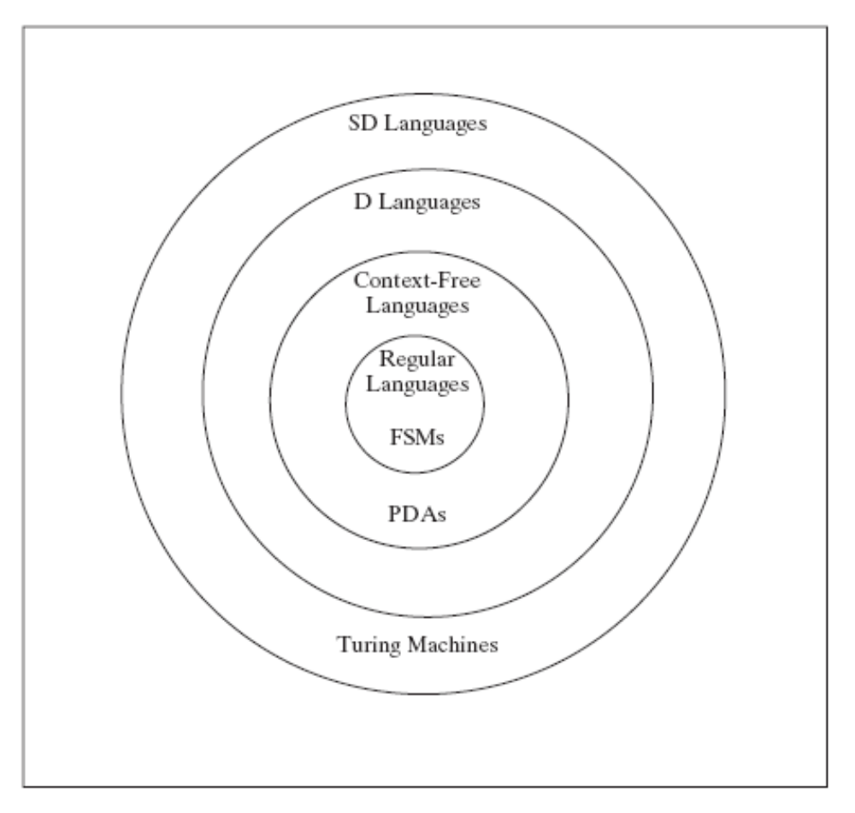
Languages and Machines

Slide 60
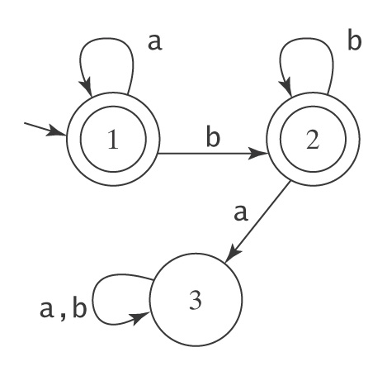
Finite State Machines
(Finite Automata)
An FSM to accept a*b*:
An FSM to accept A^{n}B^{n} = {a^{n}b^{n} : n ≥ 0}

Slide 61
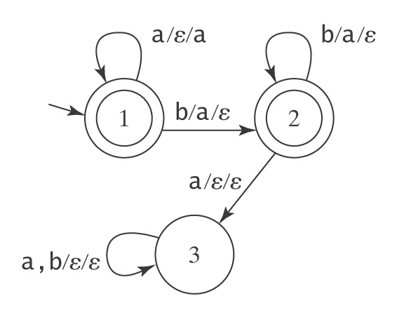
Pushdown Automata
A PDA to accept A^{n}B^{n} = {a^{n}b^{n} : n ≥ 0}
Example: aaabb
Stack:

Slide 62
Another Example
Bal, the language of balanced parentheses

Slide 63
Trying Another PDA
A PDA to accept strings of the form:
A^{n}B^{n}C^{n} = {a^{n}b^{n}c^{n} : n ≥ 0}

Slide 64
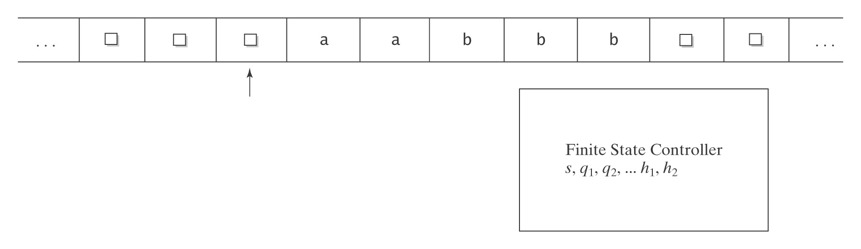
Turing Machines
A Turing Machine to accept A^{n}B^{n}C^{n}:

Slide 65
Turing Machines
A Turing machine to accept the language:
{p: p is a Java program that halts on input 0}

Slide 66
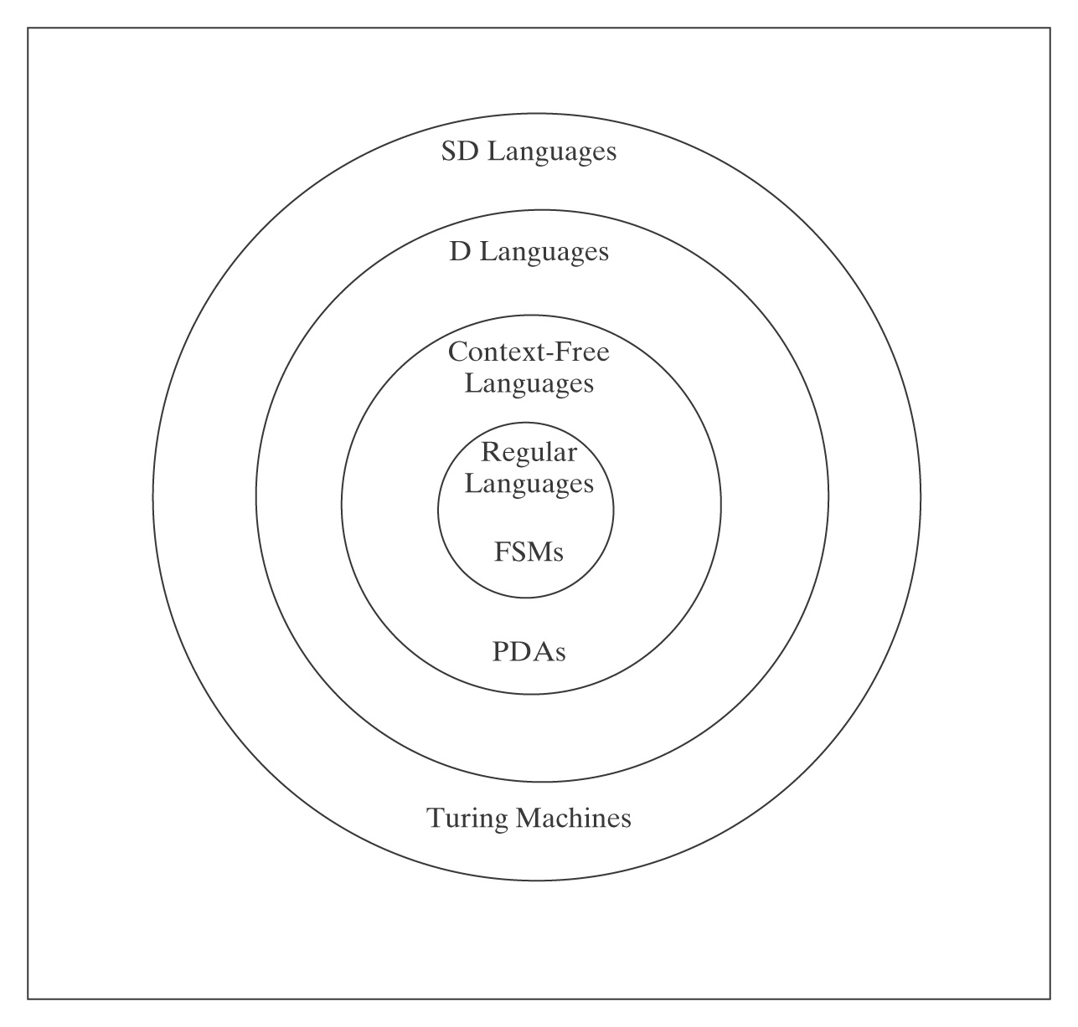
Languages and Machines
Rule of Least Power: “Use the least powerful language suitable for the given problem.”

Slide 67
Grammars, Languages, and Machines
Generates
Language
Grammar
Accepts
Machine

Slide 68
Three Computational Issues
• Decision procedures
• Nondeterminism
• Functions on languages

